Slide 1
Winter Rotorcraft Readiness
EASA Community Network - Rotorcraft

Slide 2
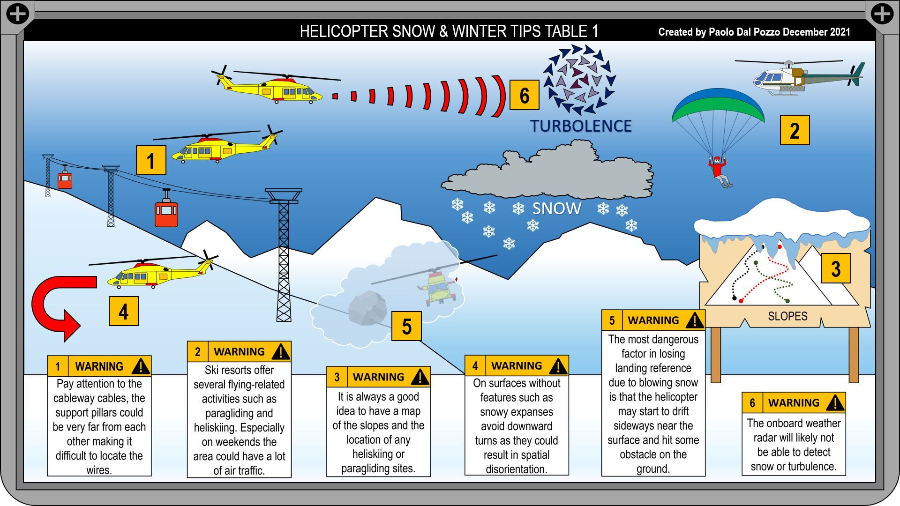

Slide 3
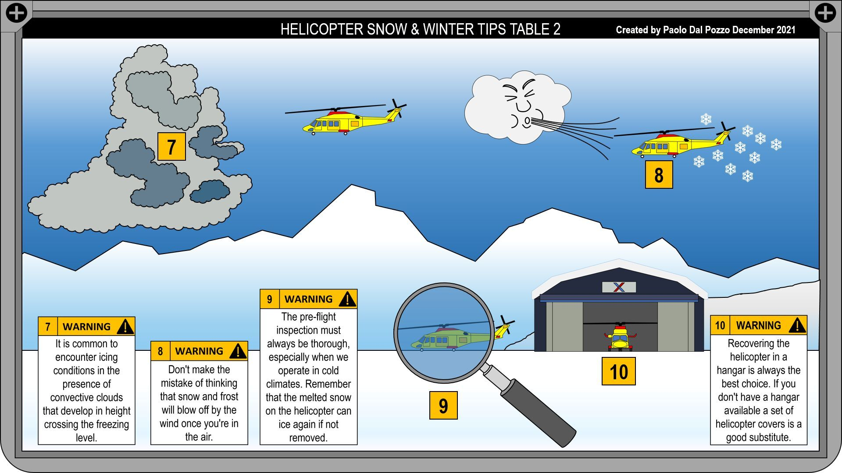

Slide 4
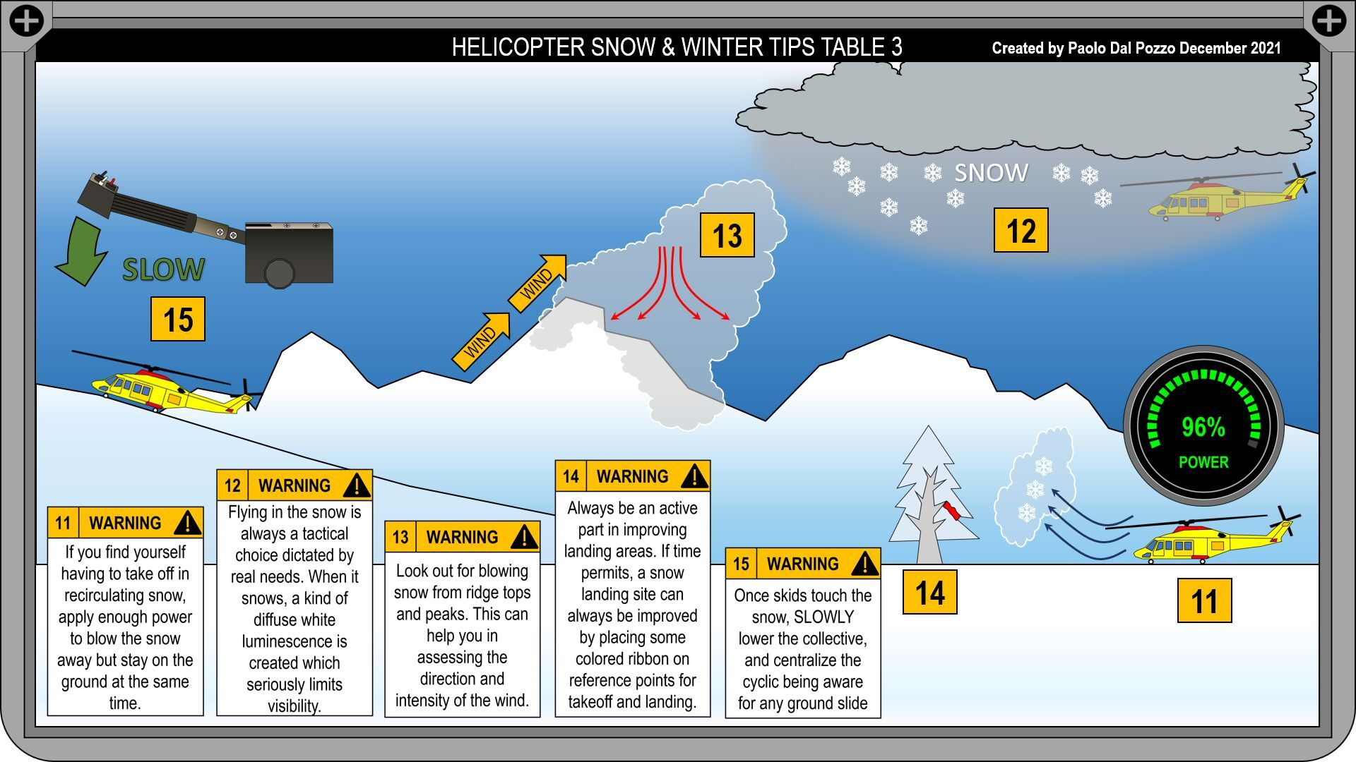

Slide 5
